Slide 1

Cryptocurrency prediction
Can we predict the future price of a cryptocurrency?

Slide 2


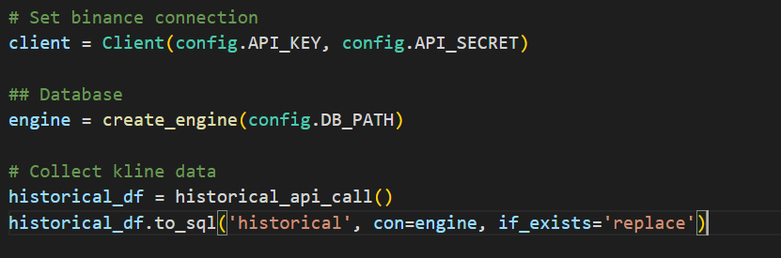
The Data
We used our previous project app to pull current data from the Binance API.
This data was then pushed to a Postgres Database in the Cloud using AWS RDS Service using a short python script.

Slide 3
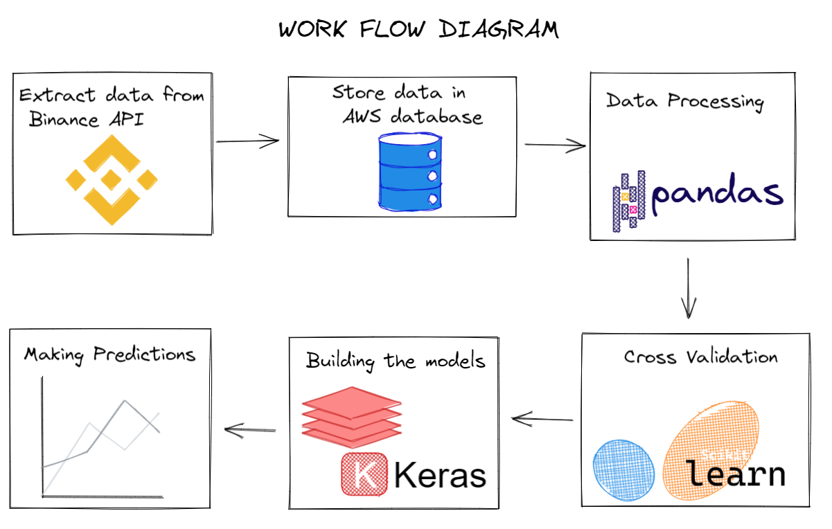
The process

Slide 4


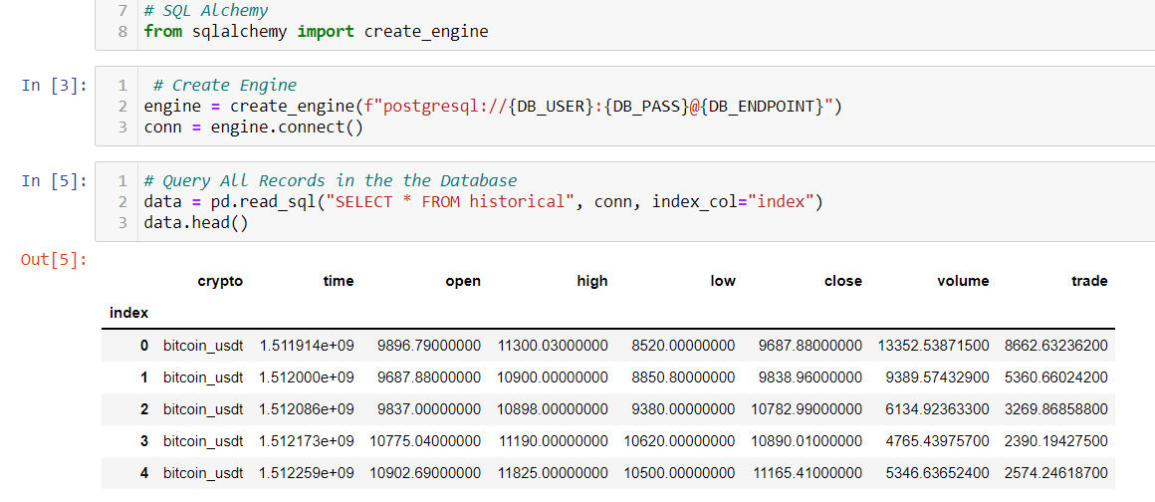

Import Data from RDS
The data was imported from RDS Postgres DB Using SQL Alchemy.

Slide 5

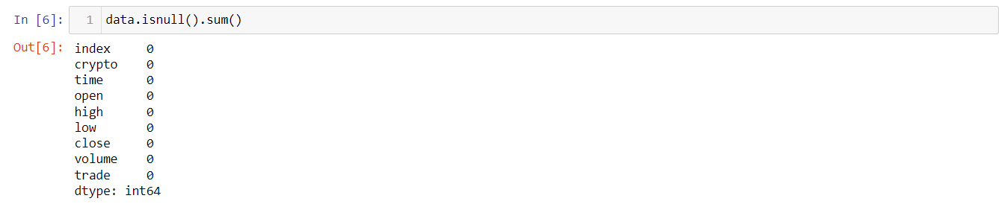
Data Cleaning
No missing values. We won’t do any further cleaning as the data is just historical records of how the cryptocurrency price had changed each day.

Slide 6

Data Transformation

Slide 7
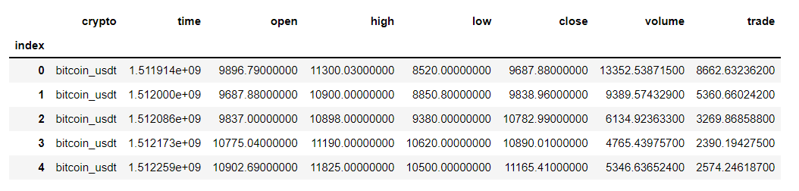
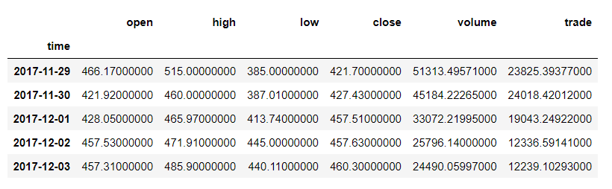
Before
Data processing steps
Filter for required cryptocurrency (Ethereum)
Reset and drop the index
Drop the cryptocurrency name column – irrelevant to our goal
Convert the time to a date (datetime)
Set the date as the index
Convert the column datatypes from string to float
After

Slide 8
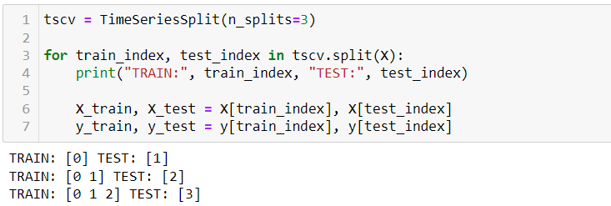
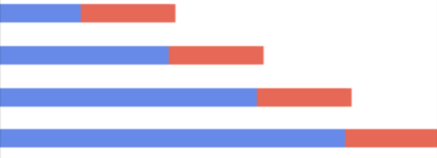
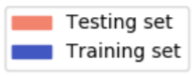
Time series data
We have to consider that our features and target are time sensitive. The price of a cryptocurrency today is influenced by it’s past price.
We can’t split our data randomly for validation using train test split.
Time series split should be used instead.
n_splits = 3 – best for 4 years.
Expanding window

Slide 9
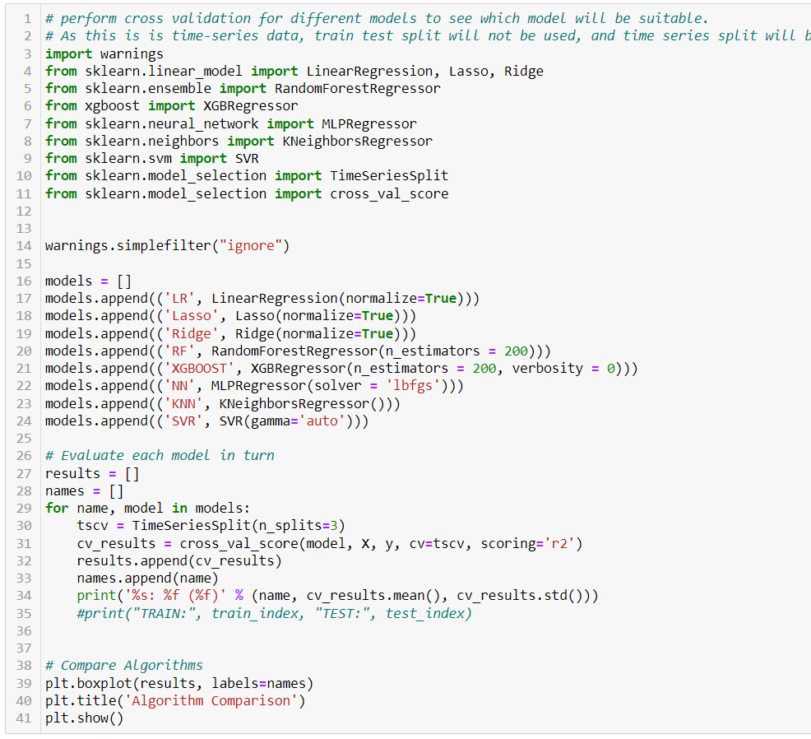
Perform Cross Validation
We want to predict the close value.
Set features and target
Test 1 : No feature engineering
Test 2 : Use close price 14 days in future as target
Test 3 : Add close price 14 days in past, and close price difference, as features

Slide 10
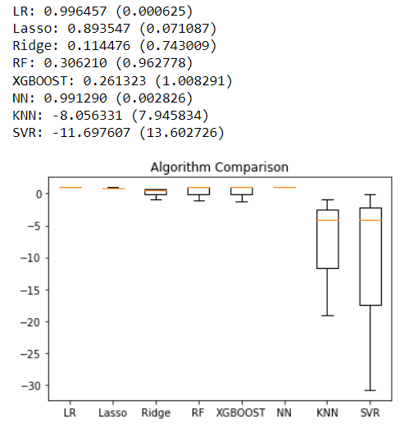
Cross validation output
- Test 1
Linear Regression,
Lasso,
NN (MLPRegressor)
appear to be the best models for this data, at least in terms of the R squared score.

Slide 11
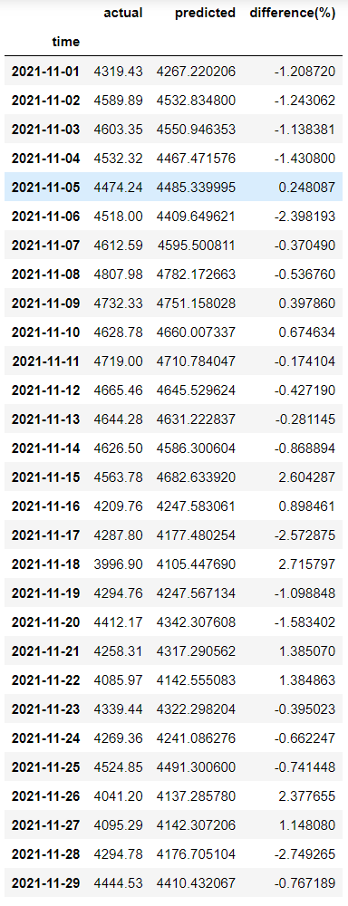
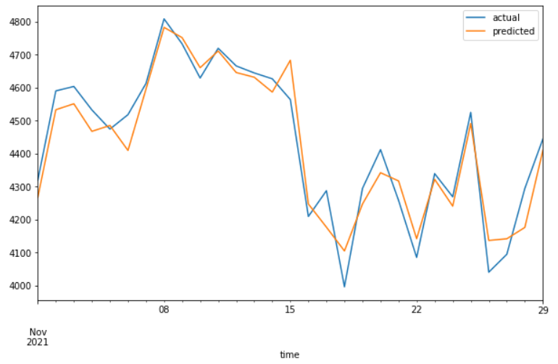
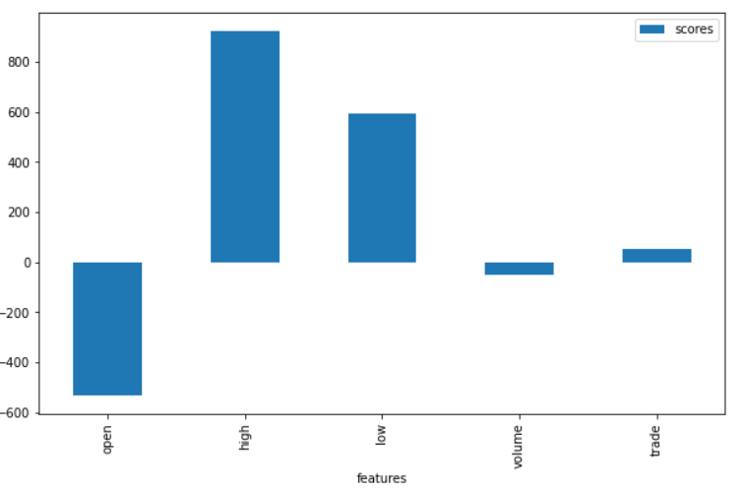
Applying the best model from CV
Linear Regression model used
X_train and y_train = 47 months
X_test and y_test = last 1 month
That’s almost 4 years to train on and 1 month to test.
Scaling was either manually set using the Standard Scaler or was passed as an argument to the model (normalize=True)
R2 Score: 0.919

Slide 12
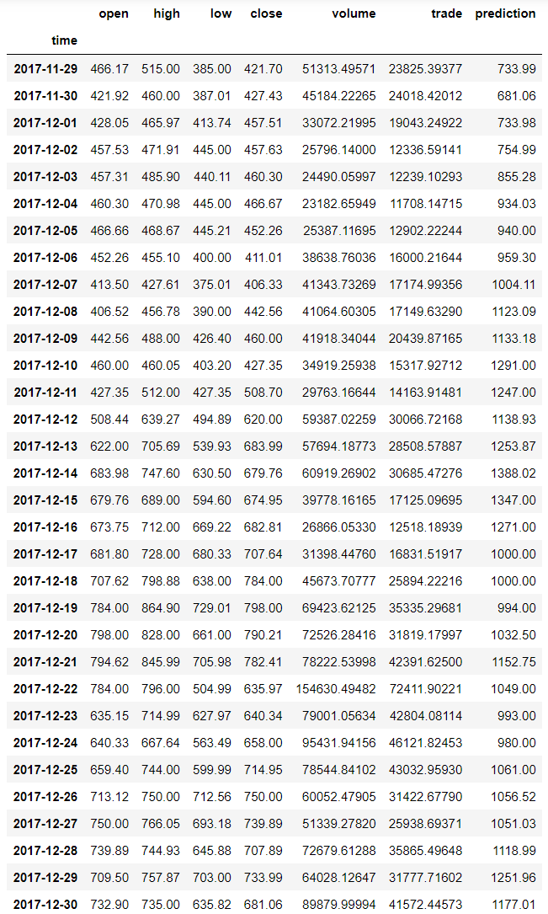
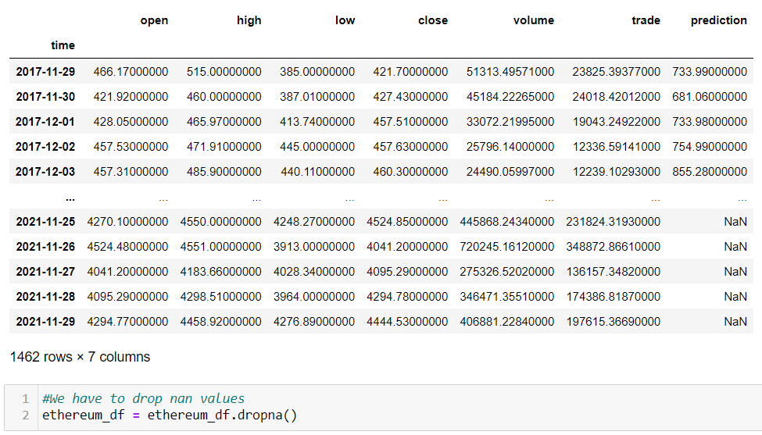
Using close price 30 days in future as the target?
Created a new column called “prediction” using the close price 14 days ahead. This column will be the target
Last 30 days which had NaN values in target dropped from data

Slide 13
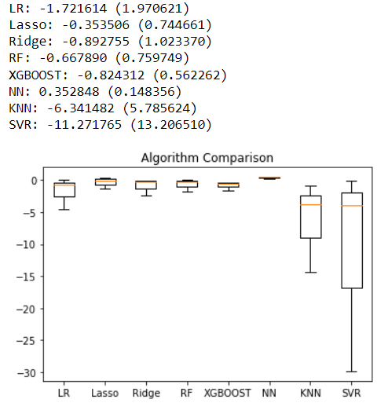
Cross validation output
Test - 2
This time Linear Regression performs poorly.
The NN (MLPRegressor) model has the best score
Something not right with the shifting the target as previously we saw Linear Regression perform extremely well.
Strange Scores?

Slide 14
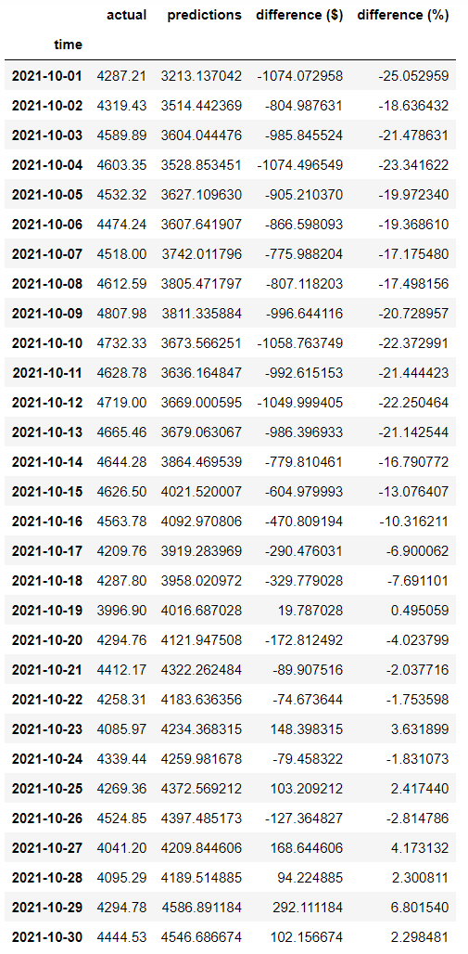
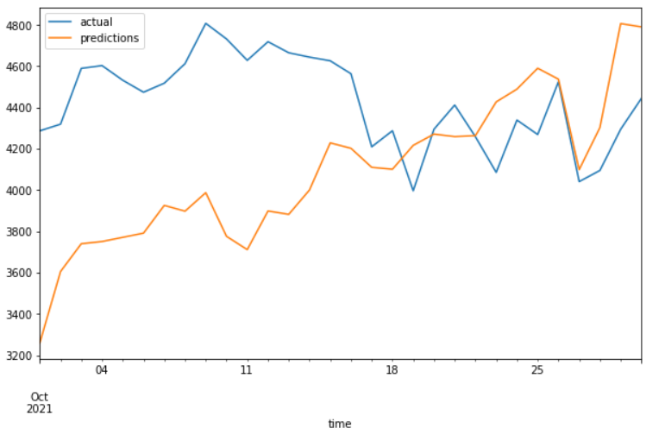
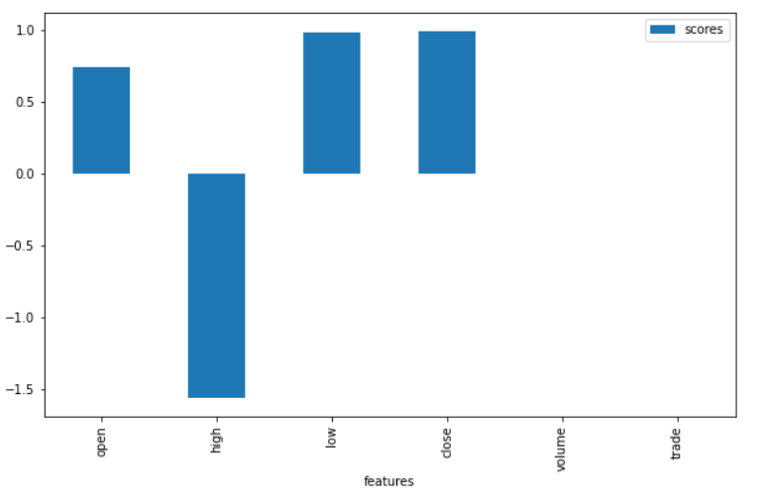
Fit model:
Linear Regression
X_train, y_train = 46 months
X_test. y_test = last 1 month
R2 Score: -6.209
Not happy with results. After some advice from John and some research, decided on a different method.

Slide 15
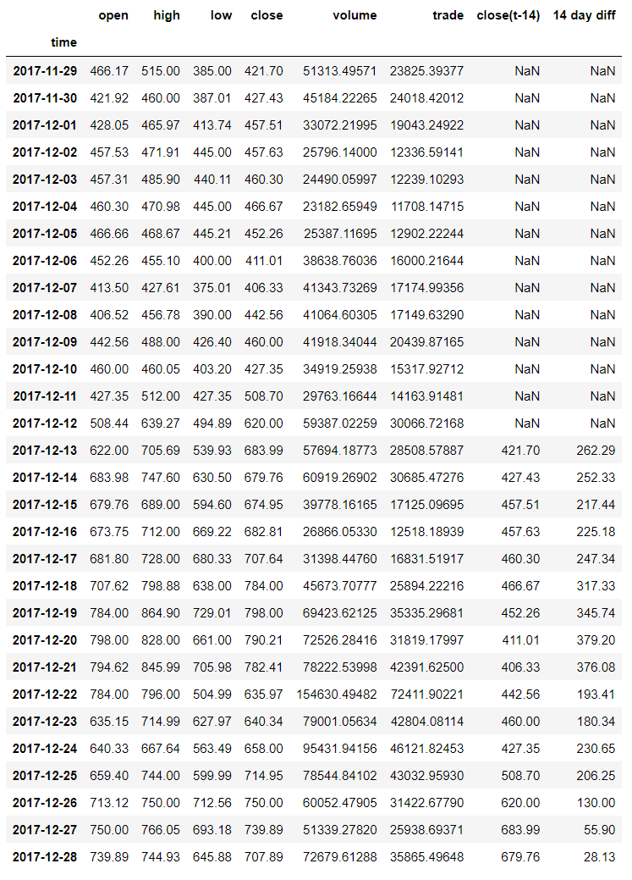
Trying a different approach –
Feature Engineering Lag Features
Adjusting the target does not seem to be the correct approach. We know the close values today impact the close values in the future. So let’s add the close value 14 days ago as what’s called a lag feature.
Next we also add the difference between the current close value and the close value 14 days ago as another feature
This is a form of tuning in order to achieve a better score for what we are trying to predict. Which is the future close value.
First 14 days with NaN values dropped

Slide 16
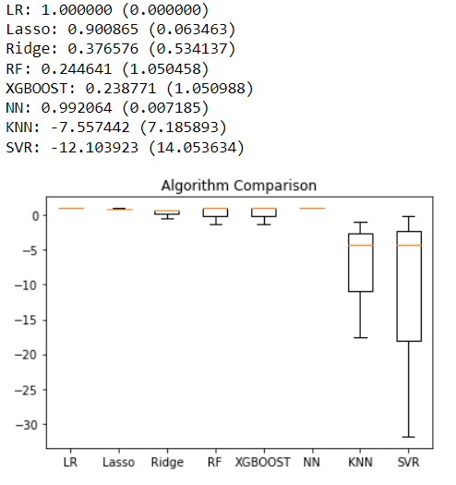
Cross validation output
Test 3
Linear Regression
Lasso
NN (MLPRegressor)
All have amazing scores with Linear Regression scoring a perfect 1 average across all splits.

Slide 17
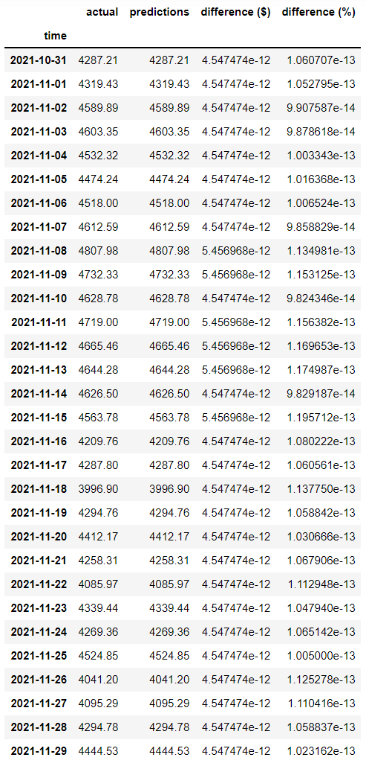
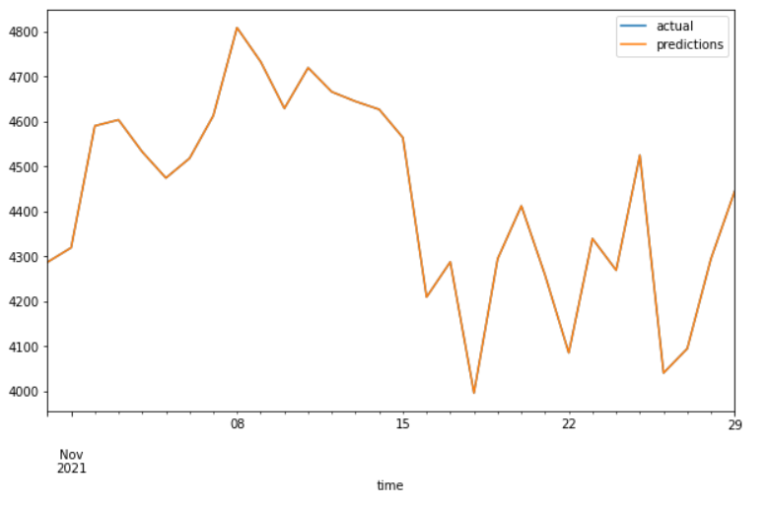
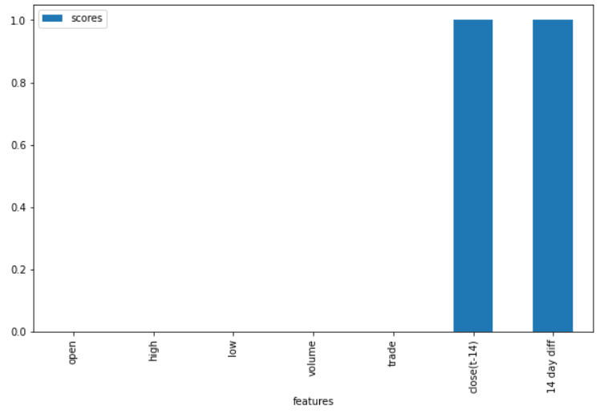
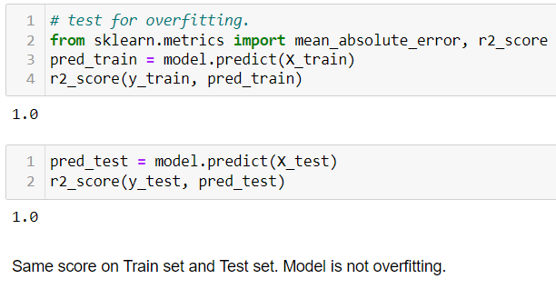
Fit model:
Linear Regression
X_train, y_train = 47 months
X_test. y_test = last 1 month
R2 Score: 1.0 MAE Score: 4.729e-12
Negligible difference between actual and predicted. Seems too good to be true…

Slide 18
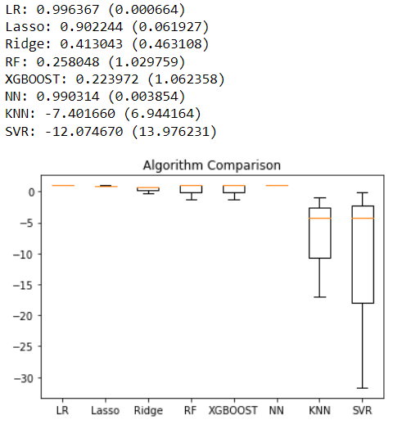
Comparison
Test 1: Original data
Test 2: Shifted Target
Test 3: Lag Features

Slide 19
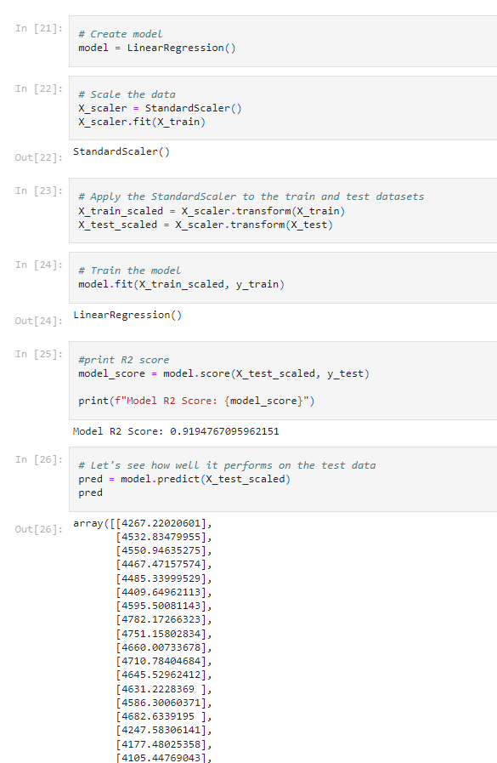
Linear regression model
Following the cross- validation, a linear regression model was built for each of the three tests.
The model was fitted to the training data and tested against the test data

Slide 20
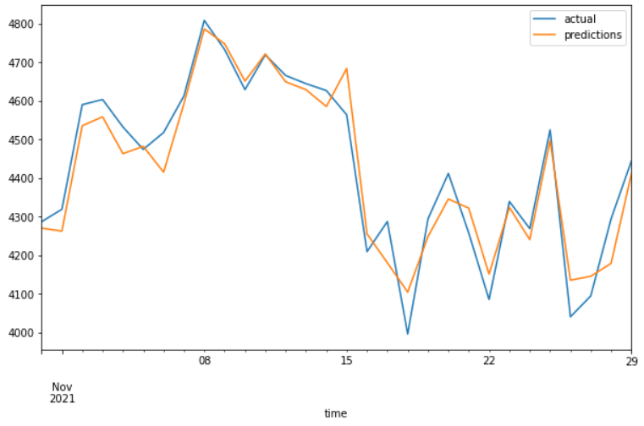
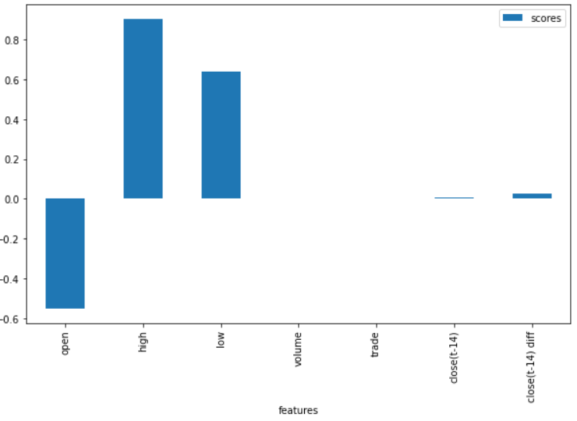
Comparison
Test 1: Original data
Test 2: Shifted Target
Test 3: Lag Features
LR R2 Score: 0.919
LR R2 Score: -6.209
LR R2 Score: 0.921

Slide 21
Recurrent Neural Network models
RNN
Long short-term memory (LSTM)
Vanilla RNN
Gated recurrent units (GRU)
RNNs are a class of neural networks which are often used with sequential data.
They are good at processing sequence data for predictions.
We are using them to predict future prices for crypto currencies

Slide 22
Transformation of time series for RNN models
Input Output
[1, 2, 3, 4] [5]
[2, 3, 4, 5] [6]
[3, 4, 5, 6] [7]
.
.
[n-1, n-2, n-3, n-4] [n]
Defining a look-back period:
A look-back period defines how many previous timesteps are used in order to predict the subsequent timestep
In our models, we used timestep=150

Slide 23
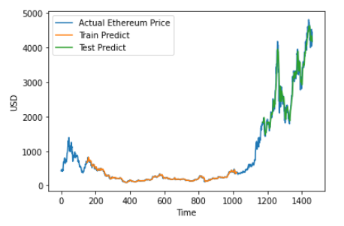
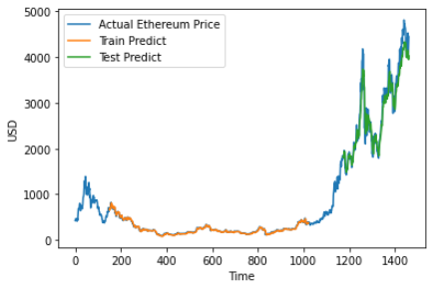
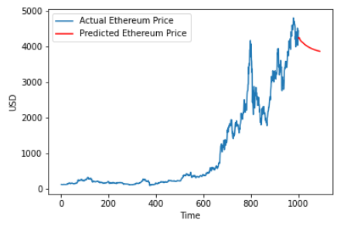
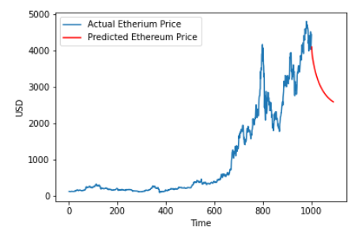
Ethereum Price Prediction using RNN models
LSTM model (R2 score: 0.926)
GRU model (R2 score: 0.937)

Slide 24
Conclusions
We have investigated data and built three models to predict prices
All models performed well
Moving forward we would use the GRU model as it produced the best R2 score
Note the models predict Ethereum prices will drop – do not invest now!
Although we got good R2 scores from our models, crypto currencies are volatile and we would expect prices are not fully explained by the features we had in the dataset.
Additional work with other features, and forecasting over a longer period to check model results, is necessary to confirm the model performance.

